Slide 1
Memory Management Fundamentals
Virtual Memory

Slide 2
Outline
Introduction
Motivation for virtual memory
Paging – general concepts
  Principle of locality, demand paging, etc.
Memory Management Unit (MMU)
Address translation & the page table
Problems introduced by paging
  Space
  Time
Page replacement algorithms

Slide 3
Intro - Memory Management in Early Operating Systems
Several processes reside in memory at one time (multiprogramming).
Early systems stored each process image in a contiguous area of memory/required the entire image to be present at run time.
Drawbacks:
  Limited number of processes at one time
    The Ready state may be empty at times
  Fragmentation of memory as new processes replace old reduces amount of usable memory

Slide 4
Intro - Memory Management in Early Operating Systems
Fragmentation of memory is caused by different size requirements for different processes.
  A 36K process leaves, a 28K process takes its place, leaving a small block of free space – a fragment
  As processes come and go, more and more fragments appear.

Slide 5
Motivation
Motivation for virtual memory:
  increase the number of processes that can execute concurrently by reducing fragmentation
  Be able to run processes that are larger than the available amount of memory
Method:
  allow process image to be loaded non-contiguously
  allow process to execute even if it is not entirely in memory.

Slide 6
Virtual Memory - Paging
Divide the address space of a program into pages (blocks of contiguous locations).
Page size is a power of 2: 4K, 8K, ...
Memory is divided into page frames of same size.
Any “page” in a program can be loaded into any “frame” in memory, so no space is wasted.

Slide 7
Paging - continued
General idea – save space by loading only those pages that a program needs now.
Result – more programs can be in memory at any given time
Problems:
  How to tell what’s “needed”
  How to keep track of where the pages are
  How to translate virtual addresses to physical

Slide 8
Demand Paging
How to Tell What’s Needed
Demand paging loads a page only when there is a page fault – a reference to a location on a page not in memory
The principle of locality ensures that page faults won’t occur too frequently
  Code and data references tend to cluster on a relatively small set of pages for a period of time;

Slide 9
Page Tables – How to
Know Where Pages are Loaded
The page table is an array in kernel space.
Each page table entry (PTE) represents one page in the address space of a process (entry 0: page 0 data; entry 1: page 1 data, etc.)
One field (valid bit) in the PTE indicates whether or not the page is in memory
Other fields tell which frame the page occupies, if the page has been written to, …

Slide 10
How are virtual addresses translated to physical
Process addresses are virtual – compiler assigns addresses to instructions and data without regard to physical memory.
  Virtual addresses are relative addresses
  Must be translated to physical addresses when the code is executed
Hardware support is required – too slow if done in software.

Slide 11
Memory Management Unit - MMU
Hardware component responsible for address translation, memory protection, other memory-related issues.
Receives a virtual address from the CPU, presents a physical address to memory

Slide 12
Address Translation with Paging
Virtual address Range: 0 - (2^{n} – 1), n = # of address bits
Virtual addresses can be divided into two parts: the page number and the displacement or offset (p, d).
  Page # (p) is specified by upper (leftmost) k bits of the address, displacement (d) by lower j bits, where n = k + j
  Page size = 2^{j}, number of pages = 2^{k}.

Slide 13
Example
For n = 4 there are 2⁴ = 16 possible addresses: 0000 – 1111
Let k = 1 and j = 3; there are 2 pages (0 & 1) with 8 addresses per page (000 -111)
Or, if k = 2 and j = 2 there are 4 pages with 4 addresses per page
If n = 16, k = 6, j = 10 how big are the pages? How many pages are there?

Slide 14
Address Translation
To translate into a physical address, the virtual page number (p) is replaced with the physical frame number (f) found in the page table.
The displacement remains the same.
This is easily handled in hardware.
  MMU retrieves the necessary information from the page table (or, more likely, from a structure called the Translation Lookaside Buffer).

Slide 15
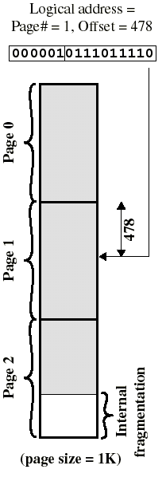
Example: page size = 1024
Consider virtual address 1502. It is located on logical page 1, at offset 478. (p, d) = 1, 478.
The binary representation of 1502 is 0000010111011110.
Divide this into a six-bit page number field: 000001₂ = 1
and a 10-bit displacement field: 0111011110₂ = 478.
When the MM hardware is presented with a binary address it can easily get the two fields.

Slide 16
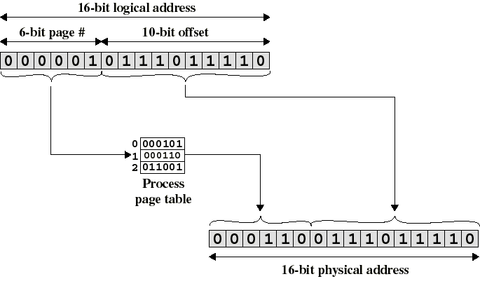
Paged Address Translation
(Notice that only the
page# field changes)

Slide 17
Page Faults
Sometimes the page table has no mapping information for a virtual page. Two possible reasons:
  The page is on disk, but not in memory
  The page is not a valid page in the process address space
In either case, the hardware passes control to the operating system to resolve the problem.

Slide 18
Problems Caused by Paging
Page tables can occupy a very large amount of memory
  One page table per process
  2^{k} entries per page table (one per page)
Page table access introduces an extra memory reference every time an instruction or data item is fetched or a value is stored to memory.

Slide 19
Solving the Space Problem
Page the page table!
A tree-structured page table allows only the currently-in-use portions of the page table to actually be stored in memory.
  This works pretty well for 32-bit addresses using a three-level table
  64-bit addresses need 4 levels to be practical
Alternative: Inverted page tables

Slide 20
Solving the Space Problem with Inverted Page Tables
An inverted page table has one entry for each physical page frame
  PTE contains PID if needed, virtual page #, dirty bit, etc.
One table; size determined by physical, not virtual, memory size.
But … how to find the right mapping info for a given page?
  Search the table – very slow

Slide 21
Inverted Page Tables with Hashing
Solution: Hash the virtual page number (& PID) to get a pointer into the inverted page table
  If i is a virtual page #, then H(i) is the position in the inverted table of the page table entry for page i.
  H(i) points to the frame number where the actual page is stored (ignoring collisions).
Traditional page tables: indexed by virtual page #.
Inverted page tables: indexed by physical frame #.
Typical inverted page table entry:
Virtual page # PID control bits chain

Slide 22
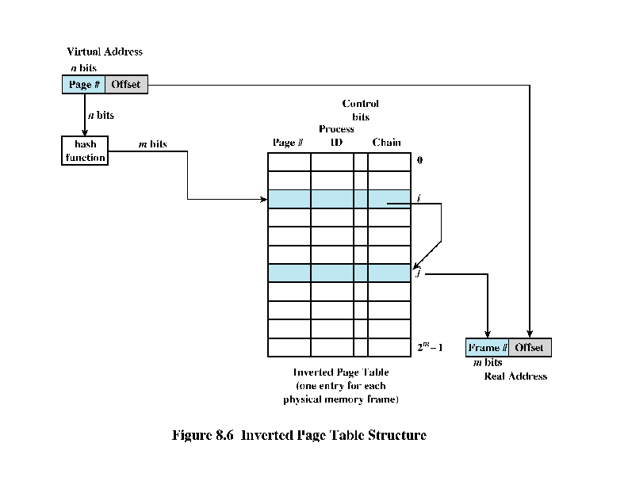
Operating Systems, William Stallings, Pearson Prentice Hall 2005

Slide 23
Pros & Cons of Inverted Tables
Disadvantages: collisions
  Use chaining to resolve collisions
    Requires an additional entry in the page table
    Chaining adds extra time to lookups – now each memory reference can require two + (number-of- collisions) memory references.
Advantages: the amount of memory used for page tables is fixed
  Doesn’t depend on number of processes, size of virtual address space, etc.

Slide 24
Solving the Time Problem
Every form of page table requires one or more additional memory references when compared to non-paged memory systems.
  increase execution time to an unacceptable level.
Solution: a hardware cache specifically for holding page table entries, known as the Translation Lookaside Buffer, or TLB

Slide 25
TLB Structure
The TLB works just like a memory cache
  High speed memory technology, approaching register speeds
  Usually content-addressable, so it can be searched efficiently
  Search key = virtual address, result = frame number + other page table data.
Memory references that can be translated using TLB entries are much faster to resolve.

Slide 26
TLB Structure
Recently-referenced Page Table Entries (PTE’s) are stored in the TLB
  TLB entries include normal information from the page table + virtual page number
TLB hit: memory reference is in TLB
TLB miss: memory reference is not in TLB
  If desired page is in memory, get its info from the page table
  Else, page fault.

Slide 27
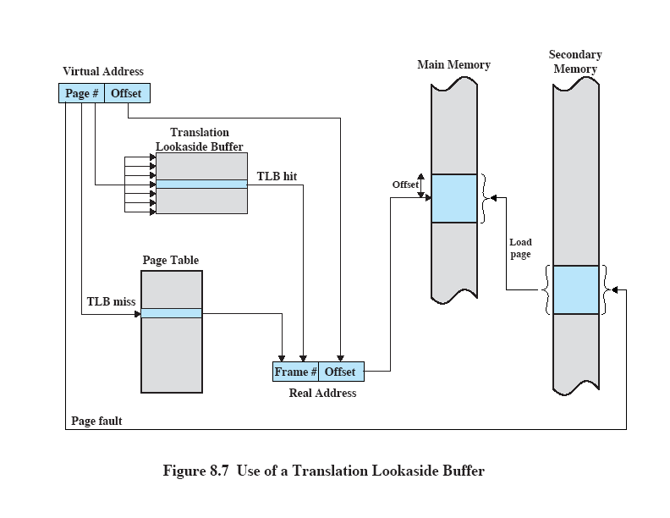
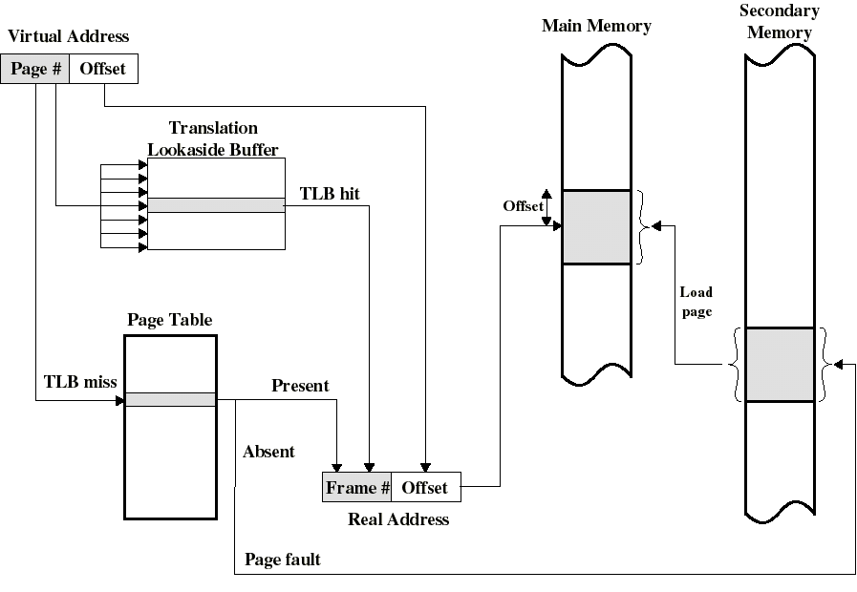
Translation Lookaside Buffer
Operating Systems, William Stallings, Pearson Prentice Hall 2005

Slide 28
TLB/Process Switch
When a new process starts to execute TLB entries are no longer valid
  Flush the TLB, reload as new process executes
  Inefficient
Modern TLBs may have an additional field for each PTE to identify the process
  Prevents the wrong information from being used.

Slide 29
OS Responsibilities in VM Systems
Maintain/update page tables
  Action initiated by addition of new process to memory or by a page fault
Maintain list of free pages
Execute page-replacement algorithms
Write “dirty” pages back to disk
Sometimes, update TLB (TLB may be either hardware or software managed)

Slide 30
Page Replacement
Page replacement algorithms are needed when a page fault occurs and memory is full.
Use information collected by hardware to try to guess which pages are no longer in use
Most common approach: some variation of Least Recently Used (LRU), including various Clock
  Keep pages that have been referenced recently on the assumption that they are in the current locality
Free frame pool is replenished periodically.

Slide 31
Page Replacement - comments
Locality of reference is weaker today due mainly to OO programming
  Lots of small functions & objects
  Dynamic allocation/deallocation of objects on heap is more random than allocation on stack.
OS generally maintains a pool of free frames and uses them for both page replacement and for the file system cache. This also affects requirements for replacement.

Slide 32
Benefits of Virtual Memory
Illusion of very large physical memory
Protection: by providing each process a separate virtual address space
  Page table mechanism prevents one process from accessing the memory of another
  Hardware is able to write-protect designated pages
Sharing
  Common code (libraries, editors, etc.)
  For shared memory communication

Slide 33
Problems
Space
  Page tables occupy large amounts of memory
  One page table/process
Time
  Each address that is translated requires a page table access
  Effectively doubles memory access time unless TLB or other approach is used.

Slide 34

Any Questions?

